Slide 1
Bi-Weekly Status Meeting
May 2, 2012

Slide 2
Topics
Welcome, Dr. Prableen Singh
FHA Portal
  HHS Proposed Process for Data Approval
  Hosting/Cost Discussion
Interoperability Architecture
  UML Diagram
  Business Questions
  NwHIN Data Update
Management Architecture
FHIM Update
Managing Board Agenda Suggestions (Architecture items)

Slide 3
FHA Portal Data Approval
HHS Proposed Process for Approving Extraction of Data from the EA Repository
  Proposed rule: All data extractions must be approved before the extraction is executed. All owners of extracted data must approve the extraction.
  Problem: FHA data is dynamic and it is by nature cross-OPDIV, even cross-agency. There will be a significant overhead if all involved OPDIVS need to review and approve the proposed extraction every time FHA needs to refresh data on the portal.
  Our proposed solution: Define each extraction as a rule (algorithm) that determines the set of instances to extract and the property values to extract for each instance type. There are two benefits to this. (a) The EA community only needs to approve the rule once and public data can be refreshed as often as needed. (b) The rule will serve as a specification for the EA technical staff in implementing the extraction.

Slide 4
FHA Portal Hosting/Cost Information
Issue:
  An email from a colleague on the HHS EA team a few days ago read as : “Can you setup a call to discuss the hosting and managing of a "public" site for FHA data by the EA Technical Team?
  The agenda of the call would be to determine the need to host and maintain a public site for FHA EA data and the resource costs that is incurred to develop and maintain the solution and how it will be paid for. From the EA management team, Brian and Kumar will be involved. I would suggest a 30 minute initial call for this discussion.”
  We propose:
  Have the meeting to find out if they are truly looking for funding, or only for a resource estimate

Slide 5
Interoperability Architecture
FHA Modeling Framework (UML Diagram, covers both MA & IA)
Business Questions for the Portal
NwHIN Data Update

Slide 6
Architecture Content
Layer | Class | Instance Examples
Business | Processes/ workflow | “Prescribing”, “transfer of care”, “public health reporting”
 | Organizations/ Users | SSA, DoD, VA, MedVirginia
 | Actors | “physician”, “pharmacist”
Data (IEP’s - information exchange packages, aligned with S&I Framework standards) | IEP, Specification | Data payload (e.g. C32), HITSP, HL-7 2.5 ADT
 | Origin | Organizational unit that originates the data
Systems (includes the interfaces among systems) | Interfaces (aligned with S&I Framework standards) | “XCPD”, “DIRECT”, “HL7 2.5.1 ADT”
 | Owner (e.g. agency, dept.) | “SSA Office of Disability Systems”, “VA Hospital”

Slide 7
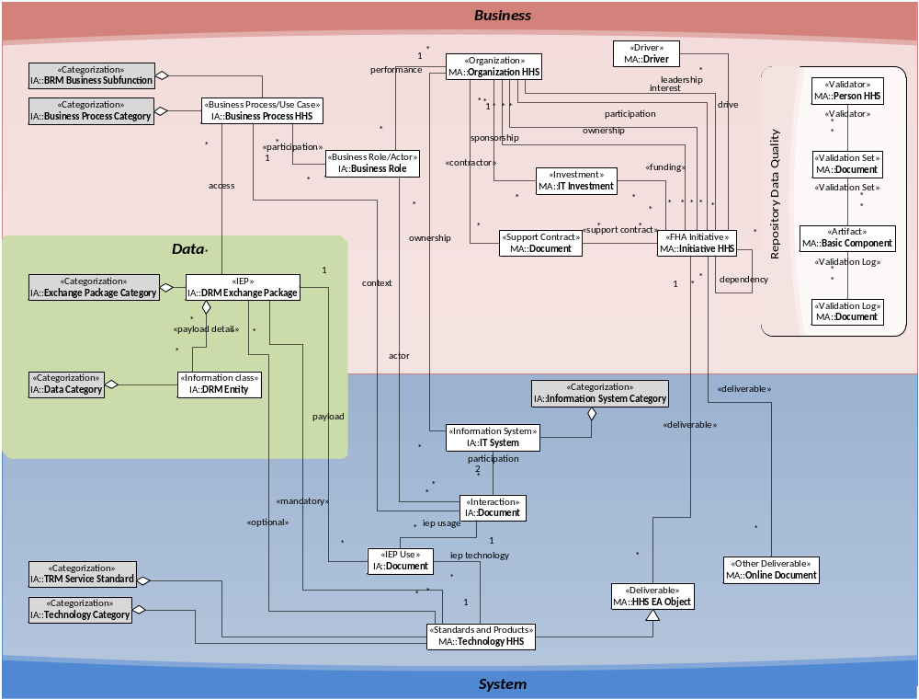
FHA Modeling Framework (IA and MA)

Slide 8
Business Questions for the Portal (proposal)
  What organizations are participating in NwHIN Exchange?
  What other participants are exchanging data with a given participant (i.e., which of their systems are interacting?)
  What is the purpose of a given interaction? (I.E., the business process context)
  What standards and specifications are used for a given interaction?

Slide 9
FHIM Update

Slide 10
Management Architecture
Is in maintenance mode
Should the Summary document be distributed?
The FHA Work In Progress Report is available for use by the Managing Board

Slide 11
Managing Board Agenda (Architecture items)
Proposed
Explanation of Portal Solution/Status Update
IA Diagram and Business Questions
  High Level
  Business Questions
Managing Architecture Brief
  Management Requirements

